Slide 1



Introduction to R for Data Science
By
Prof. Vaibhav P. Vasani
Assistant Professor
Department of Computer Engineering
K. J. Somaiya College of Engineering
Somaiya Vidyavihar University

Slide 2
R language: Overview
Open source and open development.
Design and deployment of portable, extensible, and scalable software.
Interoperability with other languages: C, XML.
Variety of statistical and numerical methods.
High quality visualization and graphics tools.
Effective, extensible user interface.
Innovative tools for producing documentation and training materials: vignettes.
Supports the creation, testing, and distribution of software and data modules: packages.

Slide 3
List of companies that use R for analytics
TechCrunch
Google
Facebook
Genpact
Bing
Orbitz
ANZ
The New York Times
Thomas Cook
Accenture
Wipro
Mozilla
Novartis
Merck

Slide 4
How companies are using R
Ford uses R to improve the design of its vehicles.
Basically, Twitter uses R to monitor user experience.
The US National Weather Service uses R to predict severe flooding.
The Human Rights Data Analysis Group uses R to quantify the impact of war.
R is being used by The New York Times to create infographics.
Google uses R to calculate the ROI of advertising campaigns.

Slide 5
More Use Cases of R Language
a. Facebook: Basically, Facebook uses R to update status and its social network graph. Also, for predicting colleague interactions with R,
b. Ford Motor Company: As Ford relies on Hadoop. Also, R for statistical analysis and data-driven decision support.
c. Google: Basically, Google uses R to calculate ROI on advertising campaigns, to predict economic activity. Also to improve the efficiency of online advertising.
d. Foursquare: As R is an important stack behind Foursquare’s famed recommendation engine.
e. John Deere: Basically, Statisticians at John Deere use R for time series modeling. Also, geospatial analysis in a reliable and reproducible way. The results are then integrated with Excel and SAP.

Slide 6
More Use Cases of R Language
f. Microsoft: Microsoft uses R for the Xbox matchmaking service. Also, as a statistical engine within the Azure ML framework.
g. Mozilla: Generally, it is the foundation behind the Firefox web browser, uses R to visualize Web activity.
h. New York Times: Basically, R is used in the news cycle at The New York Times to crunch data and prepare graphics before they go to print or online.
i. Thomas Cook: Thomas Cook uses R for Prediction. Also, Fuzzy Logic to automate price settings of their last-minute offers.
j. National Weather Service: Basically, the National Weather Service uses R at its River Forecast Centers. Thus, it is used to generate graphics for flood forecasting.
k. Twitter: R is part of Twitter’s Data Science toolbox for sophisticated statistical modeling.
l. Trulia: Trulia, the real-estate analysis website uses R for predicting house prices and local crime rate.
m. ANZ Bank: ANZ, the fourth largest bank in Australia uses R for its credit risk analysis.

Slide 7
Why is R important for data science?
You can run your code without any Compiler – R is an interpreted language. Hence we can run Code without any compiler. R interprets the Code and makes the development of code easier.
Many calculations done with vectors – R is a vector language, so anyone can add functions to a single Vector without putting in a loop. Hence, R is powerful and faster than other languages.
Statistical Language– R used in biology, genetics as well as in statistics. R is a turning complete language where any type of task can perform.

Slide 8
Why is R Good for Business?
The most important reason why R is good for business is that it is an open source. R is great for visualization. As per new research, R has far more capabilities as compared to earlier tools.
For data-driven business, data science talent shortage is a very big problem. Companies are using R programming as their platform and recruit trained users of R.

Slide 9
Using R as calculator
Example
Arithmetic 🡪 2+2, 2*3,2-12, 12/2,2**2

Slide 10
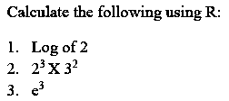
Practice

Slide 11
Character
Input
Name = “Krishna”
Name2 <- “Radha”
Output
Name
Name2
Print(Name)

Slide 12
Data Types
There are two types of data classified on very broad level. They are Numeric and Character data.
Numeric Data: - It includes 0~9, “.” and “- ve” sign.
Character Data: - Everything except Numeric data type is Character. For Example, Names, Gender etc.
Data is also classified as Quantitative and Qualitative.
For Example, “1,2,3…” are Quantitative Data while “Good”, “Bad” etc. are Qualitative Data.
Although we can convert Qualitative Data into Quantitative Data using Ordinal Values.
For Example, “Good” can be rated as 9 while “Average” can be rated as 5 and “Bad” can be rated as 0

Slide 13
R-objects not data types
Vectors
Lists
Matrices
Arrays
Factors
Data Frames

Slide 14
Data Type | Example | Verify
Logical | TRUE, FALSE | v <- TRUE print(class(v)) it produces the following result − [1] "logical"
Numeric | 12.3, 5, 999 | v <- 23.5 print(class(v)) it produces the following result − [1] "numeric"
Integer | 2L, 34L, 0L | v <- 2L print(class(v)) it produces the following result − [1] "integer"

Slide 15
Data Type | Example | Verify
Complex | 3 + 2i | v <- 2+5i print(class(v)) it produces the following result − [1] "complex"
Character | 'a' , '"good", "TRUE", '23.4' | v <- "TRUE" print(class(v)) it produces the following result − [1] "character"
Raw | "Hello" is stored as 48 65 6c 6c 6f | v <- charToRaw("Hello") print(class(v)) it produces the following result − [1] "raw"

Slide 16
Vectors
When you want to create vector with more than one element, you should use c() function which means to combine the elements into a vector.
# Create a vector.
apple <- c('red','green',"yellow")
print(apple)
# Get the class of the vector.
print(class(apple))

Slide 17
Multiple Elements Vector
# Creating a sequence from 5 to 13.
v <- 5:13
print(v)
# Creating a sequence from 6.6 to 12.6.
v <- 6.6:12.6
print(v)
# If the final element specified does not belong to the sequence then it is discarded.
v <- 3.8:11.4
print(v)

Slide 18
Using sequence (Seq.) operator
# Create vector with elements from 5 to 9 incrementing by 0.4.
print(seq(5, 9, by = 0.4))
Using the c() function
# The logical and numeric values are converted to characters.
s <- c('apple','red',5,TRUE)
print(s)

Slide 19
Variable
Variable Name | Validity | Reason
var_name2. | valid | Has letters, numbers, dot and underscore
var_name% | Invalid | Has the character '%'. Only dot(.) and underscore allowed.
2var_name | invalid | Starts with a number
.var_name, var.name | valid | Can start with a dot(.) but the dot(.)should not be followed by a number.
.2var_name | invalid | The starting dot is followed by a number making it invalid.
_var_name | invalid | Starts with _ which is not valid

Slide 20
Variable Assignment
# Assignment using equal operator.
var.1 = c(0,1,2,3)
# Assignment using leftward operator.
var.2 <- c("learn","R")
# Assignment using rightward operator.
c(TRUE,1) -> var.3
print(var.1)
cat ("var.1 is ", var.1 ,"\n")
cat ("var.2 is ", var.2 ,"\n")
cat ("var.3 is ", var.3 ,"\n")
The cat() function combines multiple items into a continuous print output.

Slide 21
Finding Variables
print(ls())
Or
ls()
# List the variables starting with the pattern "var". print(ls(pattern = "var"))
The variables starting with dot(.) are hidden, they can be listed using "all.names = TRUE" argument to ls() function.
print(ls(all.name = TRUE))

Slide 22
Deleting Variables
rm(var.3)
print(var.3)

Slide 23
Operators
Arithmetic Operators
Relational Operators
Logical Operators
Assignment Operators
Miscellaneous Operators

Slide 24
Arithmetic Operators
Operator | Description | Example
+ | Adds two vectors | v <- c( 2,5.5,6) t <- c(8, 3, 4) print(v+t) it produces the following result − [1] 10.0 8.5 10.0
− | Subtracts second vector from the first | v <- c( 2,5.5,6) t <- c(8, 3, 4) print(v-t)it produces the following result − [1] -6.0 2.5 2.0
* | Multiplies both vectors | v <- c( 2,5.5,6) t <- c(8, 3, 4) print(v*t) it produces the following result − [1] 16.0 16.5 24.0
/ | Divide the first vector with the second | v <- c( 2,5.5,6) t <- c(8, 3, 4) print(v/t) When we execute the above code, it produces the following result − [1] 0.250000 1.833333 1.500000
%% | Give the remainder of the first vector with the second | v <- c( 2,5.5,6) t <- c(8, 3, 4) print(v%%t) it produces the following result − [1] 2.0 2.5 2.0
%/% | The result of division of first vector with second (quotient) | v <- c( 2,5.5,6) t <- c(8, 3, 4) print(v%/%t) it produces the following result − [1] 0 1 1
^ | The first vector raised to the exponent of second vector | v <- c( 2,5.5,6) t <- c(8, 3, 4) print(v^t) it produces the following result − [1] 256.000 166.375 1296.000

Slide 25
Relational Operators
Operator | Description | Example
> | Checks if each element of the first vector is greater than the corresponding element of the second vector. | v <- c(2,5.5,6,9) t <- c(8,2.5,14,9) print(v>t)it produces the following result − [1] FALSE TRUE FALSE FALSE
< | Checks if each element of the first vector is less than the corresponding element of the second vector. | v <- c(2,5.5,6,9) t <- c(8,2.5,14,9) print(v < t)it produces the following result − [1] TRUE FALSE TRUE FALSE
== | Checks if each element of the first vector is equal to the corresponding element of the second vector. | v <- c(2,5.5,6,9) t <- c(8,2.5,14,9) print(v == t)it produces the following result − [1] FALSE FALSE FALSE TRUE
<= | Checks if each element of the first vector is less than or equal to the corresponding element of the second vector. | v <- c(2,5.5,6,9) t <- c(8,2.5,14,9) print(v<=t)it produces the following result − [1] TRUE FALSE TRUE TRUE
>= | Checks if each element of the first vector is greater than or equal to the corresponding element of the second vector. | v <- c(2,5.5,6,9) t <- c(8,2.5,14,9) print(v>=t)it produces the following result − [1] FALSE TRUE FALSE TRUE
!= | Checks if each element of the first vector is unequal to the corresponding element of the second vector. | v <- c(2,5.5,6,9) t <- c(8,2.5,14,9) print(v!=t)it produces the following result − [1] TRUE TRUE TRUE FALSE

Slide 26
Logical Operators
Operator | Description | Example
& | It is called Element-wise Logical AND operator. It combines each element of the first vector with the corresponding element of the second vector and gives a output TRUE if both the elements are TRUE. | v <- c(3,1,TRUE,2+3i) t <- c(4,1,FALSE,2+3i) print(v&t) it produces the following result − [1] TRUE TRUE FALSE TRUE
| | It is called Element-wise Logical OR operator. It combines each element of the first vector with the corresponding element of the second vector and gives a output TRUE if one the elements is TRUE. | v <- c(3,0,TRUE,2+2i) t <- c(4,0,FALSE,2+3i) print(v|t) it produces the following result − [1] TRUE FALSE TRUE TRUE
! | It is called Logical NOT operator. Takes each element of the vector and gives the opposite logical value. | v <- c(3,0,TRUE,2+2i) print(!v) it produces the following result − [1] FALSE TRUE FALSE FALSE

Slide 27
Operator | Description | Example
&& | Called Logical AND operator. Takes first element of both the vectors and gives the TRUE only if both are TRUE. | v <- c(3,0,TRUE,2+2i) t <- c(1,3,TRUE,2+3i) print(v&&t)it produces the following result − [1] TRUE
|| | Called Logical OR operator. Takes first element of both the vectors and gives the TRUE if one of them is TRUE. | v <- c(0,0,TRUE,2+2i) t <- c(0,3,TRUE,2+3i) print(v||t)it produces the following result − [1] FALSE

Slide 28
Assignment Operators
Operator | Description | Example
<− or = or <<− | Called Left Assignment | v1 <- c(3,1,TRUE,2+3i) v2 <<- c(3,1,TRUE,2+3i) v3 = c(3,1,TRUE,2+3i) print(v1) print(v2) print(v3)it produces the following result − [1] 3+0i 1+0i 1+0i 2+3i [1] 3+0i 1+0i 1+0i 2+3i [1] 3+0i 1+0i 1+0i 2+3i
-> or ->> | Called Right Assignment | c(3,1,TRUE,2+3i) -> v1 c(3,1,TRUE,2+3i) ->> v2 print(v1) print(v2)it produces the following result − [1] 3+0i 1+0i 1+0i 2+3i [1] 3+0i 1+0i 1+0i 2+3i

Slide 29
Miscellaneous Operators
Operator | Description | Example
: | Colon operator. It creates the series of numbers in sequence for a vector. | v <- 2:8 print(v) it produces the following result − [1] 2 3 4 5 6 7 8
%in% | This operator is used to identify if an element belongs to a vector. | v1 <- 8 v2 <- 12 t <- 1:10 print(v1 %in% t) print(v2 %in% t) it produces the following result − [1] TRUE [1] FALSE
%*% | This operator is used to multiply a matrix with its transpose. | M = matrix( c(2,6,5,1,10,4), nrow = 2,ncol = 3,byrow = TRUE) t = M %*% t(M) print(t)it produces the following result − [,1] [,2] [1,] 65 82 [2,] 82 117

Slide 31
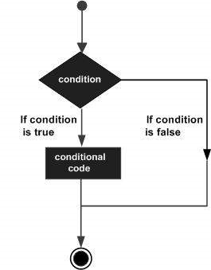
R - Decision making
Sr.No. | Statement & Description
1 | if statementAn if statement consists of a Boolean expression followed by one or more statements.
2 | if...else statementAn if statement can be followed by an optional elsestatement, which executes when the Boolean expression is false.
3 | switch statementA switch statement allows a variable to be tested for equality against a list of values.

Slide 32
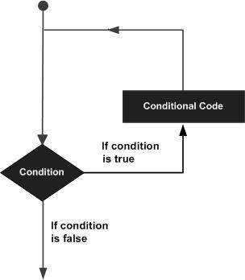
R - Loops
Sr.No. | Loop Type & Description
1 | repeat loopExecutes a sequence of statements multiple times and abbreviates the code that manages the loop variable.
2 | while loopRepeats a statement or group of statements while a given condition is true. It tests the condition before executing the loop body.
3 | for loopLike a while statement, except that it tests the condition at the end of the loop body.

Slide 33

Data Frame
A data frame is used for storing data tables. It is a list of vectors of equal length.
For example, here is a built-in data frame in R, called mtcars.
mtcars[1,2]

Slide 34
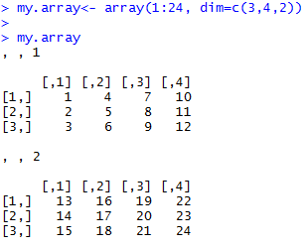
Array and Matrices
Two different options for constructing matrices or arrays
matrix () and Array ()
>my.array< - array(1:24, dim=c(3,4,2))

Slide 35
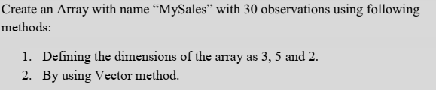
my.vector<- 1:24
dim(my.vector) <- c(3,4,2)
check whether two objects are identical by using the identical () function.
Notes:
using the dim ( ) function bit faster than using the array ( ) function; it’s especially useful if you have your data already in a vector

Slide 36
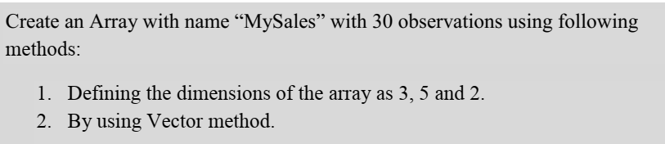
Accessing Vector Elements
Assume already have a vector with the numbers 1 through 24
my.vector <- 1:24
convert that vector to an array exactly like my.array simply by assigning the dimensions
dim(my.vector) <- c(3,4,2)

Slide 37
R - Packages
.libPaths()
library() //Get the list of all the packages installed
search() //Get all packages currently loaded in the R environment
install.packages("Package Name")//Install a New Package

Slide 38
Reading database using R
import Datasets from various sources having various files types for example
CSV File

Slide 39
Importing & Exporting CSV
CSV file
Test1.csv
mydata = read.csv("mydata.csv")
mydata

Slide 40
Loading data – data(dataset_name)
read and write functions
getwd() and setwd(dir)
read and write functions use full path name
Example:
read.csv (“C:/Rtutorials/Sampledata.csv”). Similarly for writing dataset we use the write () function.
“Getwd” means get the working directory (wd) and “setwd” is used to set the working directory

Slide 41
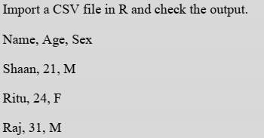

Slide 42
Outliers and Missing Data treatment
In R, missing values are represented by the symbol NA (not available).
Impossible values (e.g., dividing by zero) are represented by the symbol NaN (not a number).
y <- c(1,2,3,NA)
is.na(y)
# returns a vector (F F F T)

Slide 43
x <- c(1,2,NA,3)
mean(x)
# returns NA
To remove missing values from our dataset we use na.omit() function.
newdata<- na.omit(mydata)
x <- c(1,2,NA,3)
mean(x, na.rm=TRUE)
# returns 2

Slide 44
Outliers
Outlier is a point or an observation that deviates significantly from the other observations.
Due to experimental errors or “special circumstances”
Outlier detection tests to check for outliers
Outlier treatment –
Retention
Exclusion
Other treatment methods

Slide 45
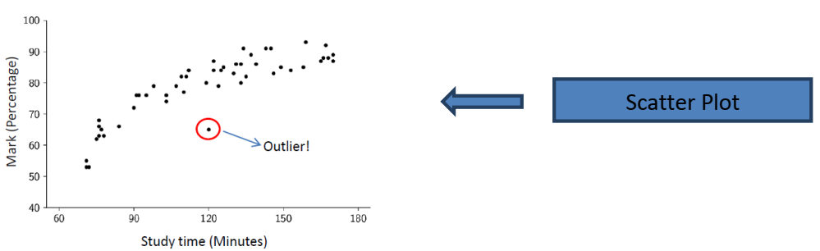
Normally we use BOX Plot and Scatter plot to find outliers from graphical representation.

Slide 46
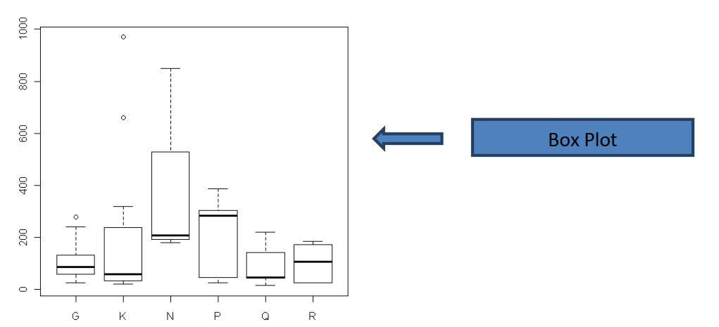

Slide 47
Combining Data sets in R
To merge two data frames (datasets) horizontally, use the merge function. In most cases, you join two data frames by one or more common key variables (i.e., an inner join).
To merge two data frames by ID:
total <- merge(data frameA,data frameB,by="ID")
To merge two data frames by ID and Country:
total <- merge(data frameA,data frameB,by=c("ID","Country"))

Slide 48
To join two data frames (datasets) vertically, use the rbind function. The two data frames must have the same variables
total <- rbind(data frameA, data frameB)

Slide 49
Note:-
If data frameA has variables that data frameB does not, then either:
1. Delete the extra variables in data frameA or
2. Create the additional variables in data frameB and set them to NA (missing)
before joining them with rbind( ).

Slide 50
Plyr package: Tools for Splitting, Applying and Combining Data.
We use rbind.fill() in plyr package in R. It binds or combines a list of data frames filling missing columns
with NA.
Example
rbind.fill(mtcars[c("mpg", "wt")], mtcars[c("wt", "cyl")])
In this all the missing value will be filled with NA.

Slide 51
For example,
if(hours > 100) net.price<- net.price * 0.9
if(public) {tot.price<- net.price * 1.06 } else
{tot.price<- net.price * 1.12} round(tot.price)}
Or it can be written as also,
if(public) tot.price<- net.price * 1.06 else
tot.price<- net.price * 1.12

Slide 52
Pie Chart
pie(x, labels, radius, main, col, clockwise) Following is the description of the parameters used −
x is a vector containing the numeric values used in the pie chart.
labels is used to give description to the slices.
radius indicates the radius of the circle of the pie chart.(value between −1 and +1).
main indicates the title of the chart.
col indicates the color palette.
clockwise is a logical value indicating if the slices are drawn clockwise or anti clockwise.

Slide 53
Pie Chart- Example
x <- c(21, 62, 10, 53) labels <- c("London", "New York", "Singapore", "Mumbai")
pie(x,labels)
pie(x, labels, main = "City pie chart", col = rainbow(length(x)))

Slide 54
Slice Percentages and Chart Legend
# Create data for the graph.
x <- c(21, 62, 10,53) labels <- c("London","New York","Singapore","Mumbai") piepercent<- round(100*x/sum(x), 1)
# Plot the chart.
pie(x, labels = piepercent, main = "City pie chart",col = rainbow(length(x))) legend("topright", c("London","New York","Singapore","Mumbai"), cex = 0.8, fill = rainbow(length(x)))

Slide 55
3D Pie Chart
# Get the library.
library(plotrix)
# Create data for the graph.
x <- c(21, 62, 10,53)
lbl <- c("London","New York","Singapore","Mumbai")
# Plot the chart.
pie3D(x,labels = lbl,explode = 0.1, main = "Pie Chart of Countries ")

Slide 56
R - Bar Charts
barplot(H,xlab,ylab,main, names.arg,col)
H is a vector or matrix containing numeric values used in bar chart.
xlab is the label for x axis.
ylab is the label for y axis.
main is the title of the bar chart.
names.arg is a vector of names appearing under each bar.
col is used to give colors to the bars in the graph.

Slide 57
# Create the data for the chart
H <- c(7,12,28,3,41)
# Plot the bar chart
barplot(H)

Slide 58
Bar Chart Labels, Title and Colors
# Create the data for the chart
H <- c(7,12,28,3,41)
M <- c("Mar","Apr","May","Jun","Jul")
# Plot the bar chart
barplot(H,names.arg=M,xlab="Month",ylab="Revenue",col="blue",
main="Revenue chart",border="red")

Slide 59
Group Bar Chart and Stacked Bar Chart
# Create the input vectors.
colors = c("green","orange","brown")
months <- c("Mar","Apr","May","Jun","Jul")
regions <- c("East","West","North")
# Create the matrix of the values.
Values <- matrix(c(2,9,3,11,9,4,8,7,3,12,5,2,8,10,11), nrow = 3, ncol = 5, byrow = TRUE)
# Create the bar chart
barplot(Values, main = "total revenue", names.arg = months, xlab = "month", ylab = "revenue", col = colors)
# Add the legend to the chart
legend("topleft", regions, cex = 1.3, fill = colors)

Slide 60
R - Boxplots
Boxplots are a measure of how well distributed is the data in a data set.
It divides the data set into three quartiles.
This graph represents the minimum, maximum, median, first quartile and third quartile in the data set.
It is also useful in comparing the distribution of data across data sets by drawing boxplots for each of them.

Slide 61
boxplot(x, data, notch, varwidth, names, main)
x is a vector or a formula.
data is the data frame.
notch is a logical value. Set as TRUE to draw a notch.
varwidth is a logical value. Set as true to draw width of the box proportionate to the sample size.
names are the group labels which will be printed under each boxplot.
main is used to give a title to the graph.

Slide 62
input <- mtcars[,c('mpg','cyl')]
print(head(input))
boxplot(mpg ~ cyl, data = mtcars, xlab = "Number of Cylinders", ylab = "Miles Per Gallon", main = "Mileage Data")

Slide 63
Boxplot with Notch
boxplot with notch to find out how the medians of different data groups match with each other.
boxplot(mpg ~ cyl, data = mtcars,
xlab = "Number of Cylinders",
ylab = "Miles Per Gallon",
main = "Mileage Data",
notch = TRUE,
varwidth = TRUE,
col = c("green","yellow","purple"),
names = c("High","Medium","Low")
)

Slide 64
R - Histograms
A histogram represents the frequencies of values of a variable bucketed into ranges.
Histogram is similar to bar chart but the difference is it groups the values into continuous ranges.
Each bar in histogram represents the height of the number of values present in that range.

Slide 65
hist(v,main,xlab,xlim,ylim,breaks,col,border)
v is a vector containing numeric values used in histogram.
main indicates title of the chart.
col is used to set color of the bars.
border is used to set border color of each bar.
xlab is used to give description of x-axis.
xlim is used to specify the range of values on the x-axis.
ylim is used to specify the range of values on the y-axis.
breaks is used to mention the width of each bar.

Slide 66
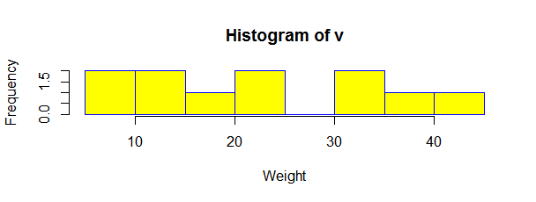
v <- c(9,13,21,8,36,22,12,41,31,33,19)
hist(v,xlab = "Weight",col = "yellow",border = "blue")

Slide 67
Range of X and Y values
v <- c(9,13,21,8,36,22,12,41,31,33,19)
hist(v,xlab = "Weight",col = "green",border = "red", xlim = c(0,40), ylim = c(0,5), breaks = 5)

Slide 68
R - Line Graphs
A line chart is a graph that connects a series of points by drawing line segments between them.
These points are ordered in one of their coordinate (usually the x-coordinate) value.
Line charts are usually used in identifying the trends in data.

Slide 69
plot(v,type,col,xlab,ylab)
v is a vector containing the numeric values.
type takes the value "p" to draw only the points, "l" to draw only the lines and "o" to draw both points and lines.
xlab is the label for x axis.
ylab is the label for y axis.
main is the Title of the chart.
col is used to give colors to both the points and lines.

Slide 70
# Create the data for the chart.
v <- c(7,12,28,3,41)
# Plot the bar chart.
plot(v,type = "o")

Slide 71
Line Chart Title, Color and Labels
# Create the data for the chart.
v <- c(7,12,28,3,41)
# Plot the bar chart.
plot(v,type = "o", col = "red", xlab = "Month", ylab = "Rain fall",
main = "Rain fall chart")

Slide 72
Multiple Lines in a Line Chart
# Create the data for the chart.
v <- c(7,12,28,3,41)
t <- c(14,7,6,19,3)
# Plot the bar chart.
plot(v,type = "o",col = "red", xlab = "Month", ylab = "Rain fall", main = "Rain fall chart")
lines(t, type = "o", col = "blue")

Slide 73
R - Scatterplots
Scatterplots show many points plotted in the Cartesian plane. Each point represents the values of two variables.
One variable is chosen in the horizontal axis and another in the vertical axis.

Slide 74
plot(x, y, main, xlab, ylab, xlim, ylim, axes)
x is the data set whose values are the horizontal coordinates.
y is the data set whose values are the vertical coordinates.
main is the tile of the graph.
xlab is the label in the horizontal axis.
ylab is the label in the vertical axis.
xlim is the limits of the values of x used for plotting.
ylim is the limits of the values of y used for plotting.
axes indicates whether both axes should be drawn on the plot.

Slide 75
input <- mtcars[,c('wt','mpg')]
print(head(input))

Slide 76
Creating the Scatterplot
# Get the input values.
input <- mtcars[,c('wt','mpg')]
# Plot the chart for cars with weight between 2.5 to 5 and mileage between 15 and 30.
plot(x = input$wt,y = input$mpg,
xlab = "Weight",
ylab = "Milage",
xlim = c(2.5,5),
ylim = c(15,30),
main = "Weight vs Milage"
)

Slide 77
Scatterplot Matrices
When we have more than two variables and we want to find the correlation between one variable versus the remaining ones we use scatterplot matrix.
We use pairs() function to create matrices of scatterplots.
pairs(formula, data)
formula represents the series of variables used in pairs.
data represents the data set from which the variables will be taken.

Slide 78
# Plot the matrices between 4 variables giving 12 plots.
# One variable with 3 others and total 4 variables.
pairs(~wt+mpg+disp+cyl,data = mtcars,
main = "Scatterplot Matrix")

Slide 79
R - Mean, Median and Mode
Statistical analysis in R is performed by using many in-built functions.
Most of these functions are part of the R base package.
These functions take R vector as an input along with the arguments and give the result.

Slide 80
# Create a vector.
x <- c(12,7,3,4.2,18,2,54,-21,8,-5)
# Find Mean.
result.mean <- mean(x)
print(result.mean)

Slide 81
Applying Trim Option
# Create a vector.
x <- c(12,7,3,4.2,18,2,54,-21,8,-5)
# Find Mean.
result.mean <- mean(x,trim = 0.3)
print(result.mean)
When trim parameter is supplied, the values in the vector get sorted and then the required numbers of observations are dropped from calculating the mean.
When trim = 0.3, 3 values from each end will be dropped from the calculations to find mean.
In this case the sorted vector is (−21, −5, 2, 3, 4.2, 7, 8, 12, 18, 54) and the values removed from the vector for calculating mean are (−21,−5,2) from left and (12,18,54) from right.

Slide 82
Applying NA Option
# Create a vector.
x <- c(12,7,3,4.2,18,2,54,-21,8,-5,NA)
# Find mean.
result.mean <- mean(x)
print(result.mean)
# Find mean dropping NA values.
result.mean <- mean(x,na.rm = TRUE)
print(result.mean)
Notes:
If there are missing values, then the mean function returns NA.
To drop the missing values from the calculation use na.rm = TRUE. which means remove the NA values.

Slide 83
Median
# Create the vector.
x <- c(12,7,3,4.2,18,2,54,-21,8,-5)
# Find the median.
median.result <- median(x)
print(median.result)
The middle most value in a data series is called the median.

Slide 84
Mode
The mode is the value that has highest number of occurrences in a set of data. Unike mean and median, mode can have both numeric and charac

Slide 85
# Create the function.
getmode <- function(v) {
uniqv <- unique(v)
uniqv[which.max(tabulate(match(v, uniqv)))]
}
# Create the vector with numbers.
v <- c(2,1,2,3,1,2,3,4,1,5,5,3,2,3)
# Calculate the mode using the user function.
result <- getmode(v)
print(result)
# Create the vector with characters.
charv <- c("o","it","the","it","it")
# Calculate the mode using the user function.
result <- getmode(charv)
print(result)

Slide 105
Thank you

